Slide 1
Welcome to the White Elephant Gift Exchange!

Slide 2
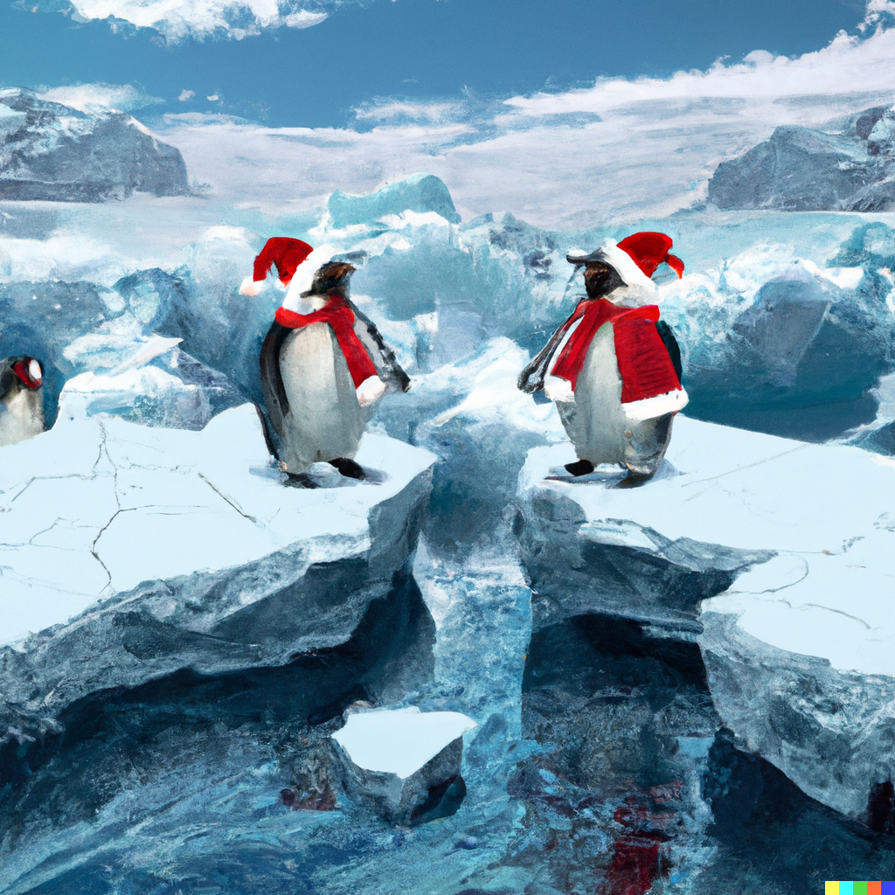
Ice Breakers !!
Introduce yourself!
What do you do in ISE?
Do you have any holiday traditions?
What is the worst gift you’ve received?

Slide 3
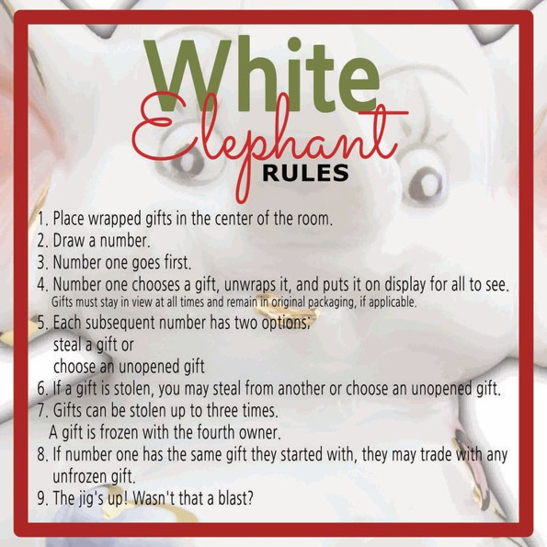

Slide 4
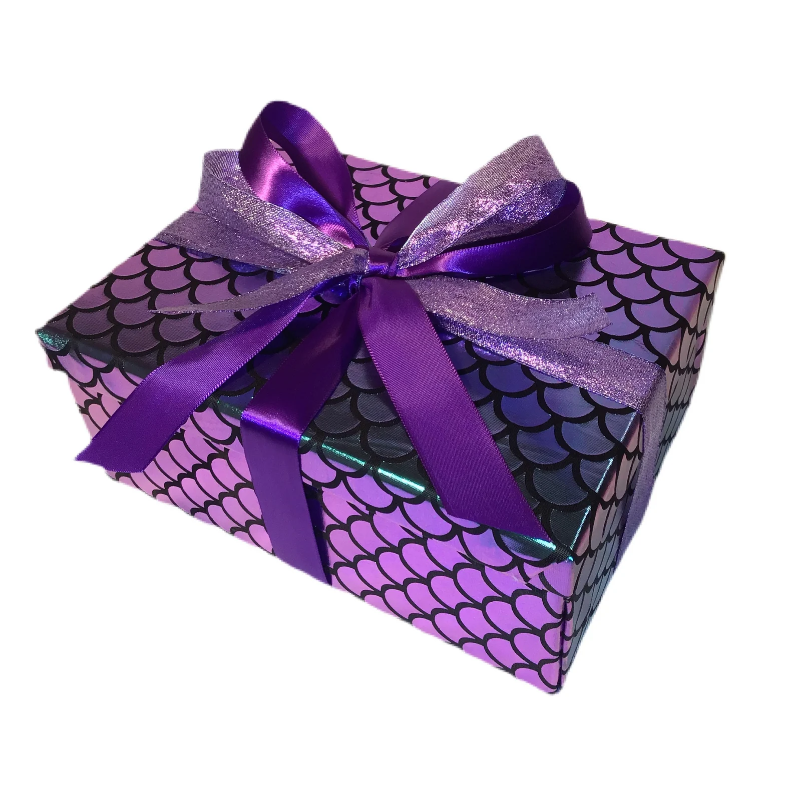
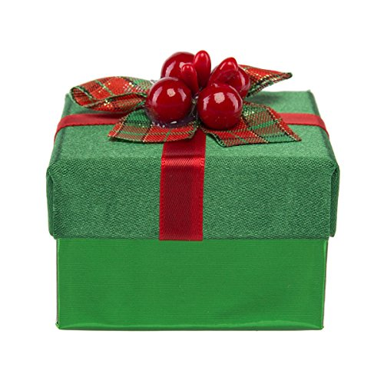

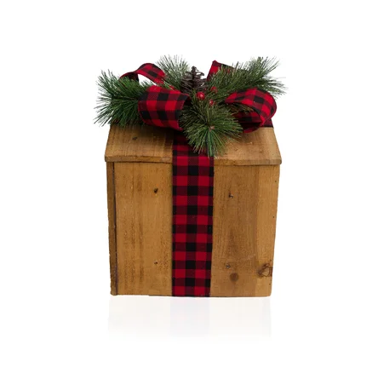
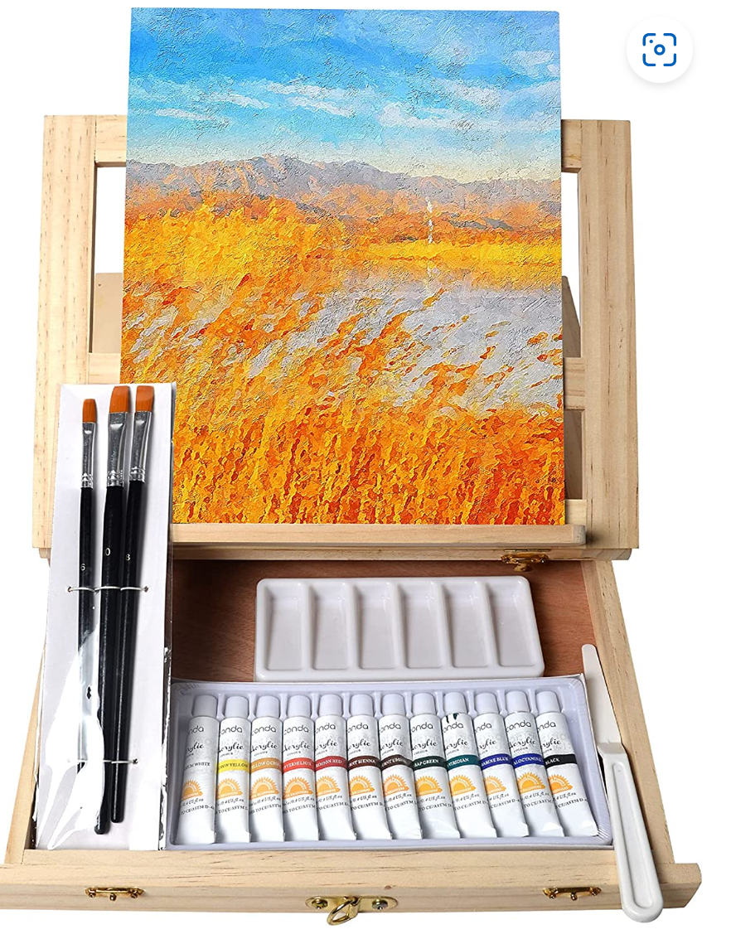
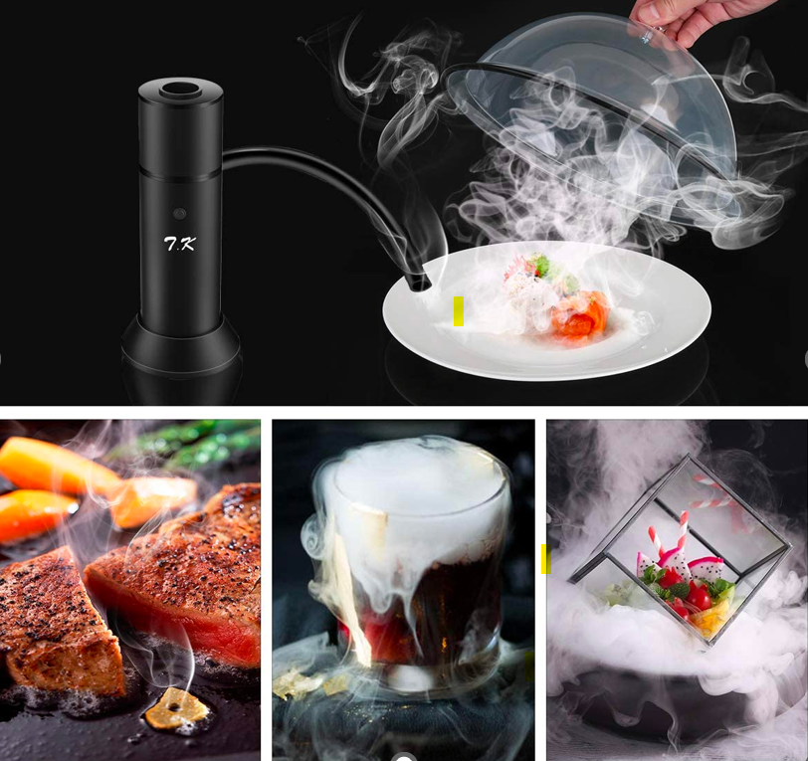
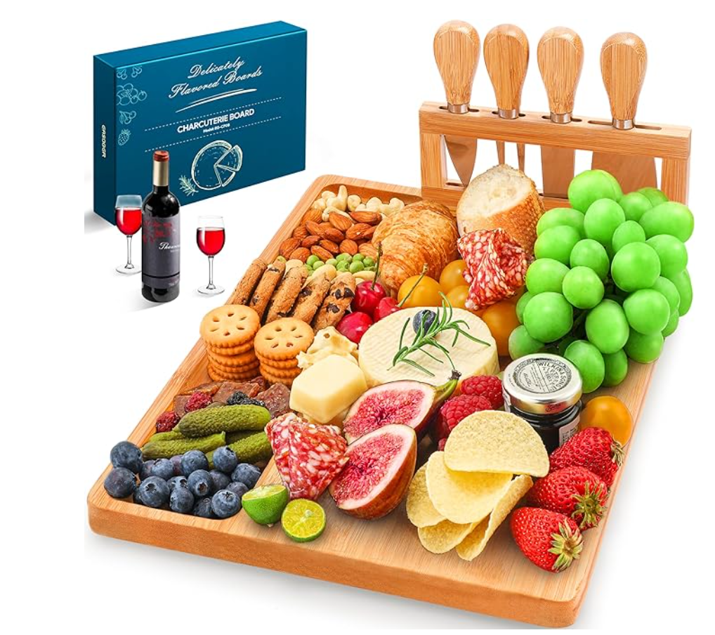
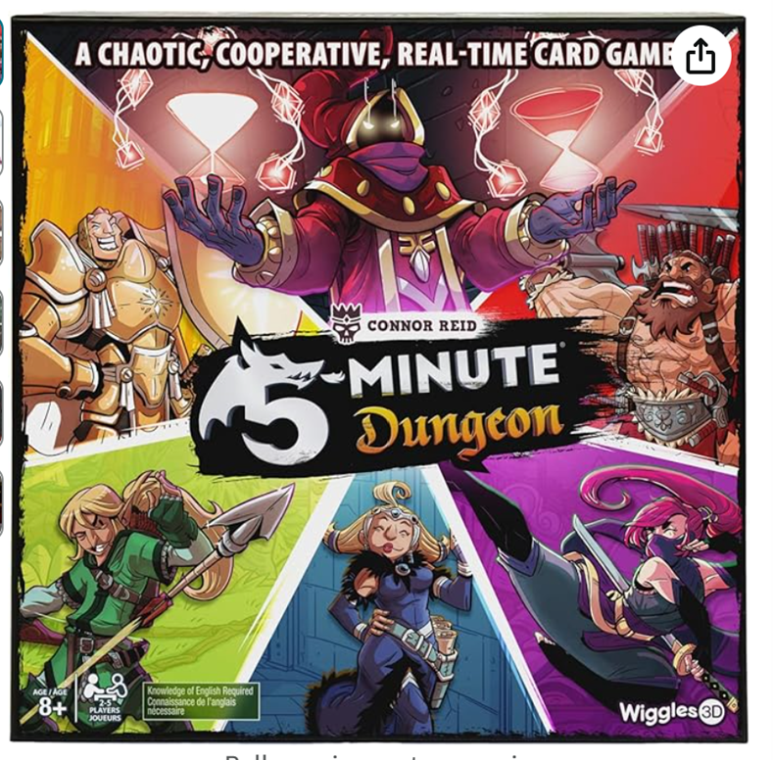
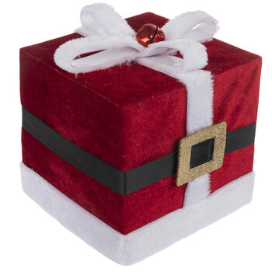

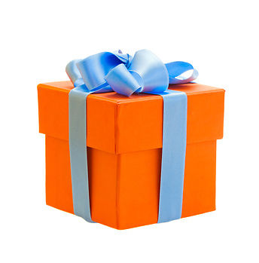
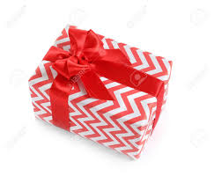
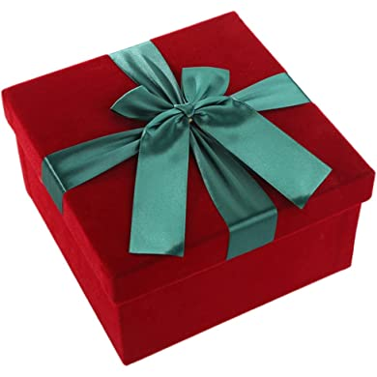
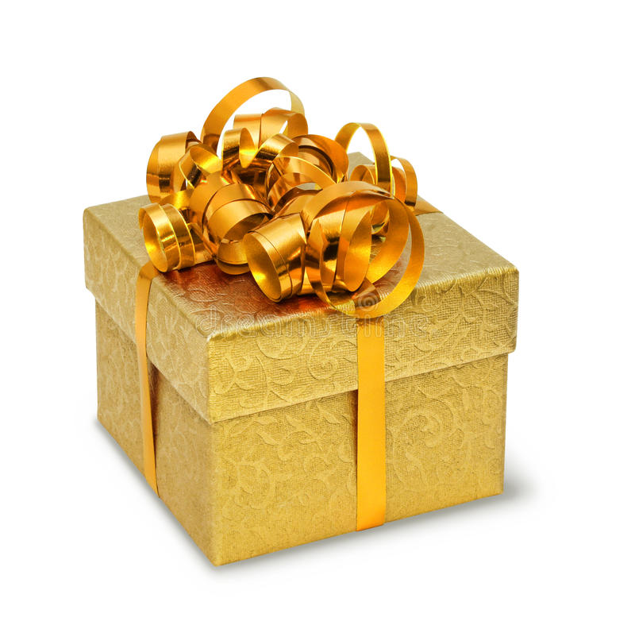
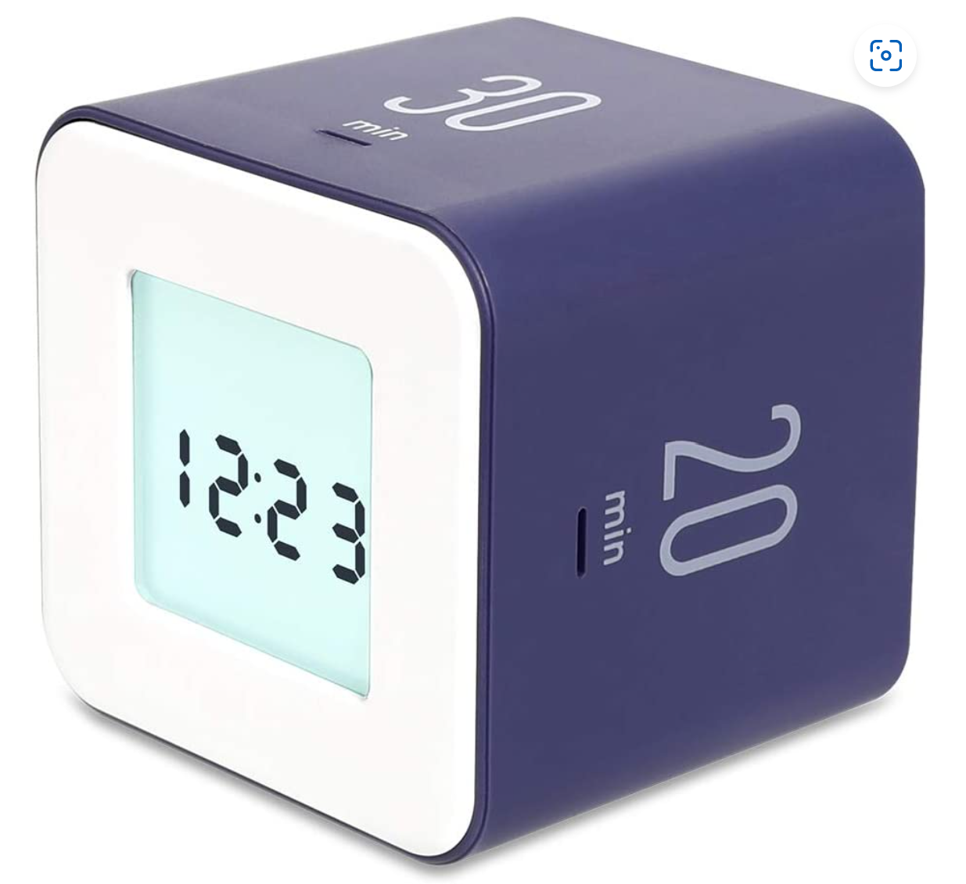
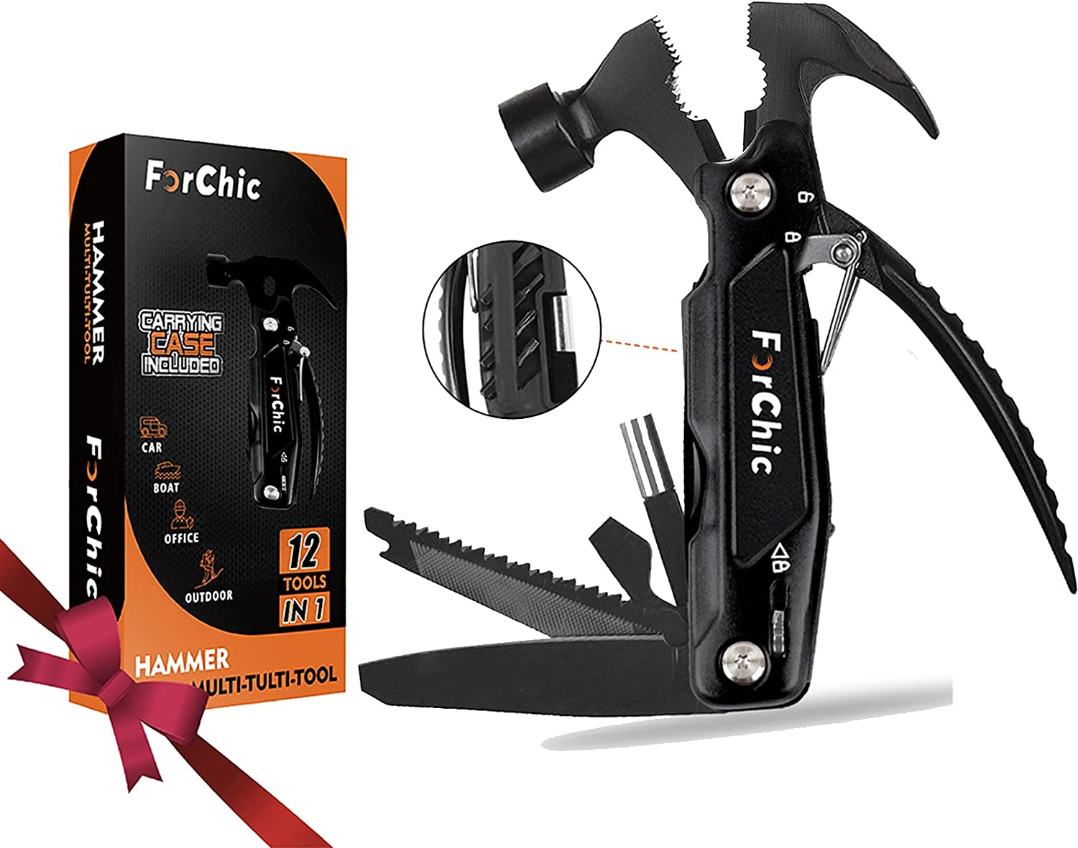
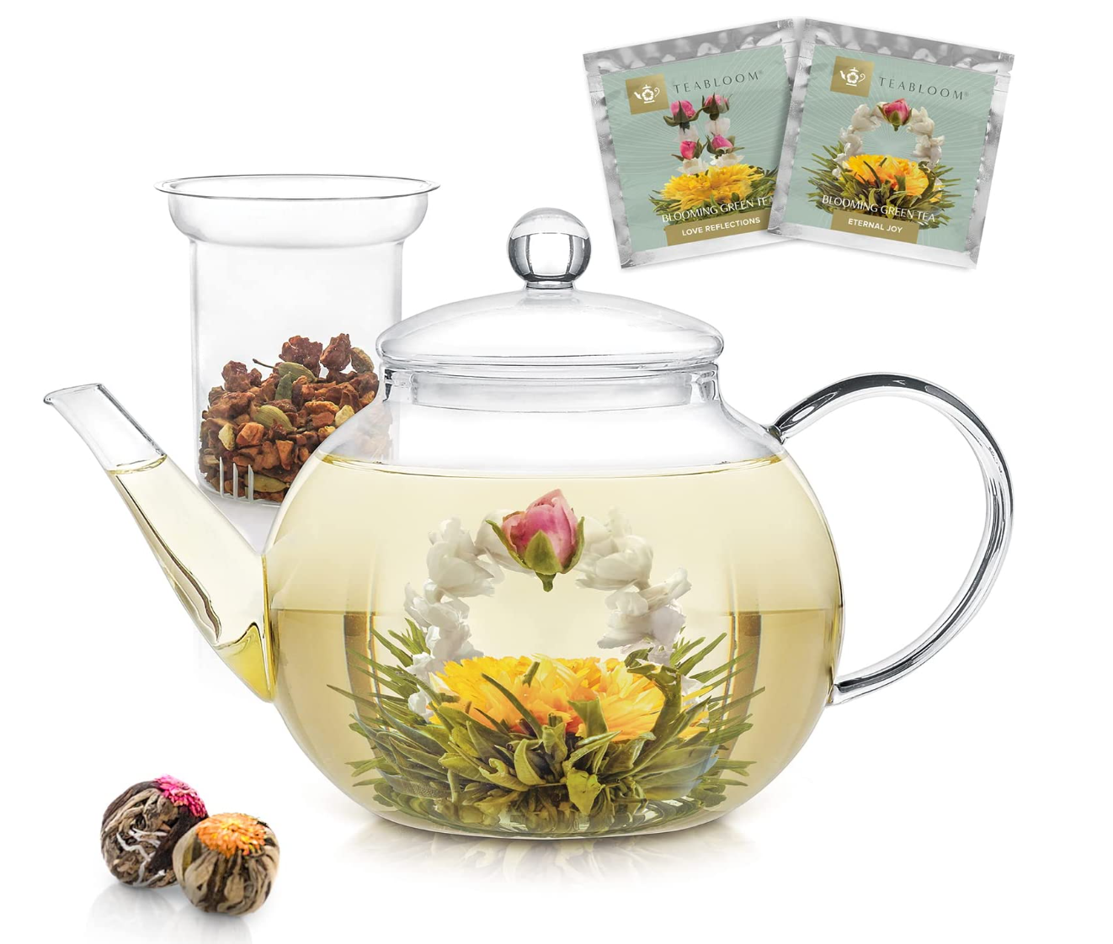
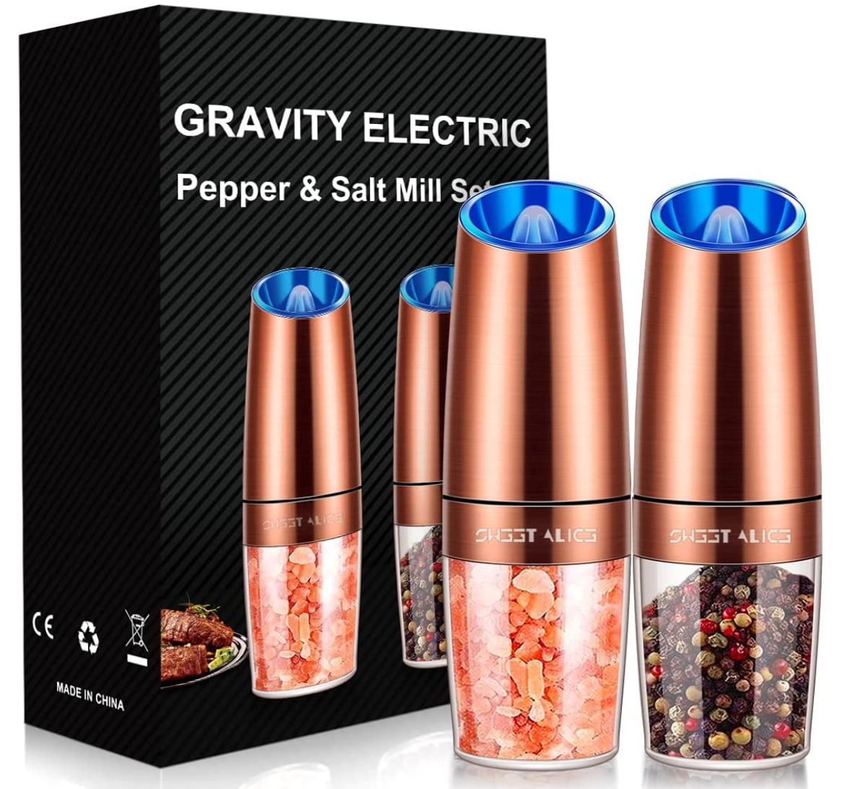
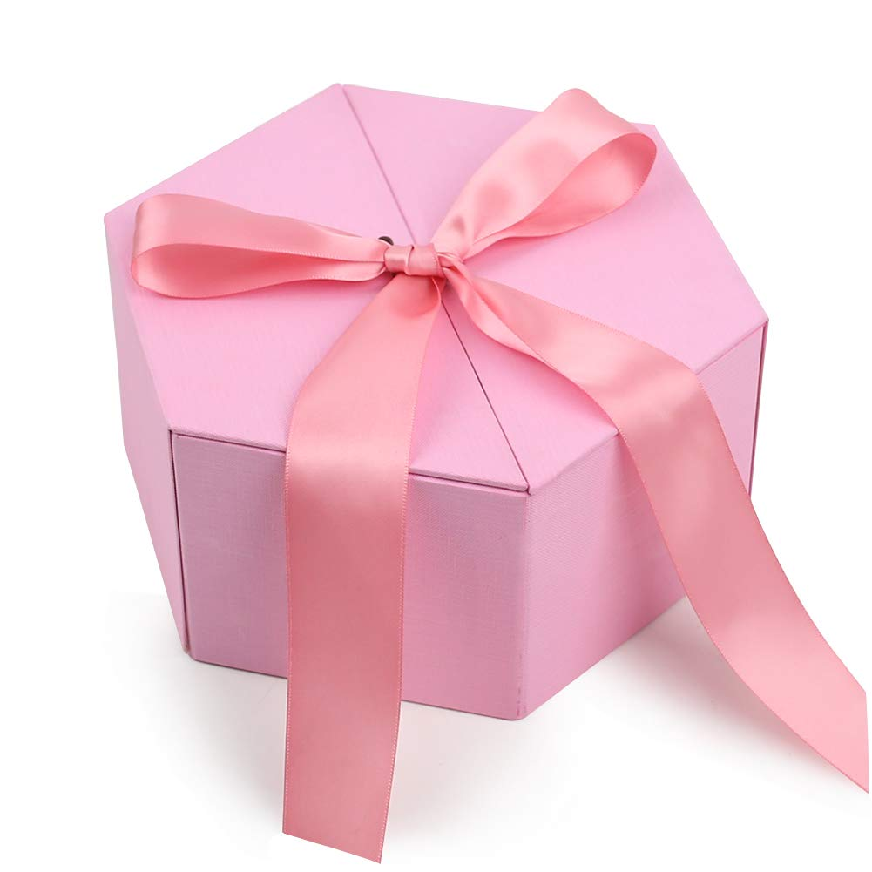



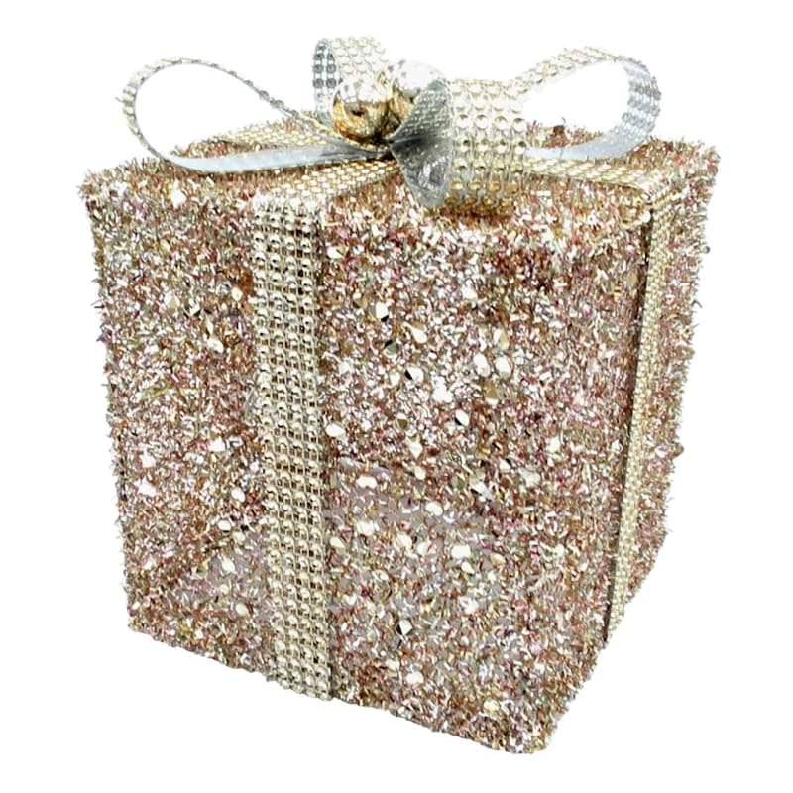
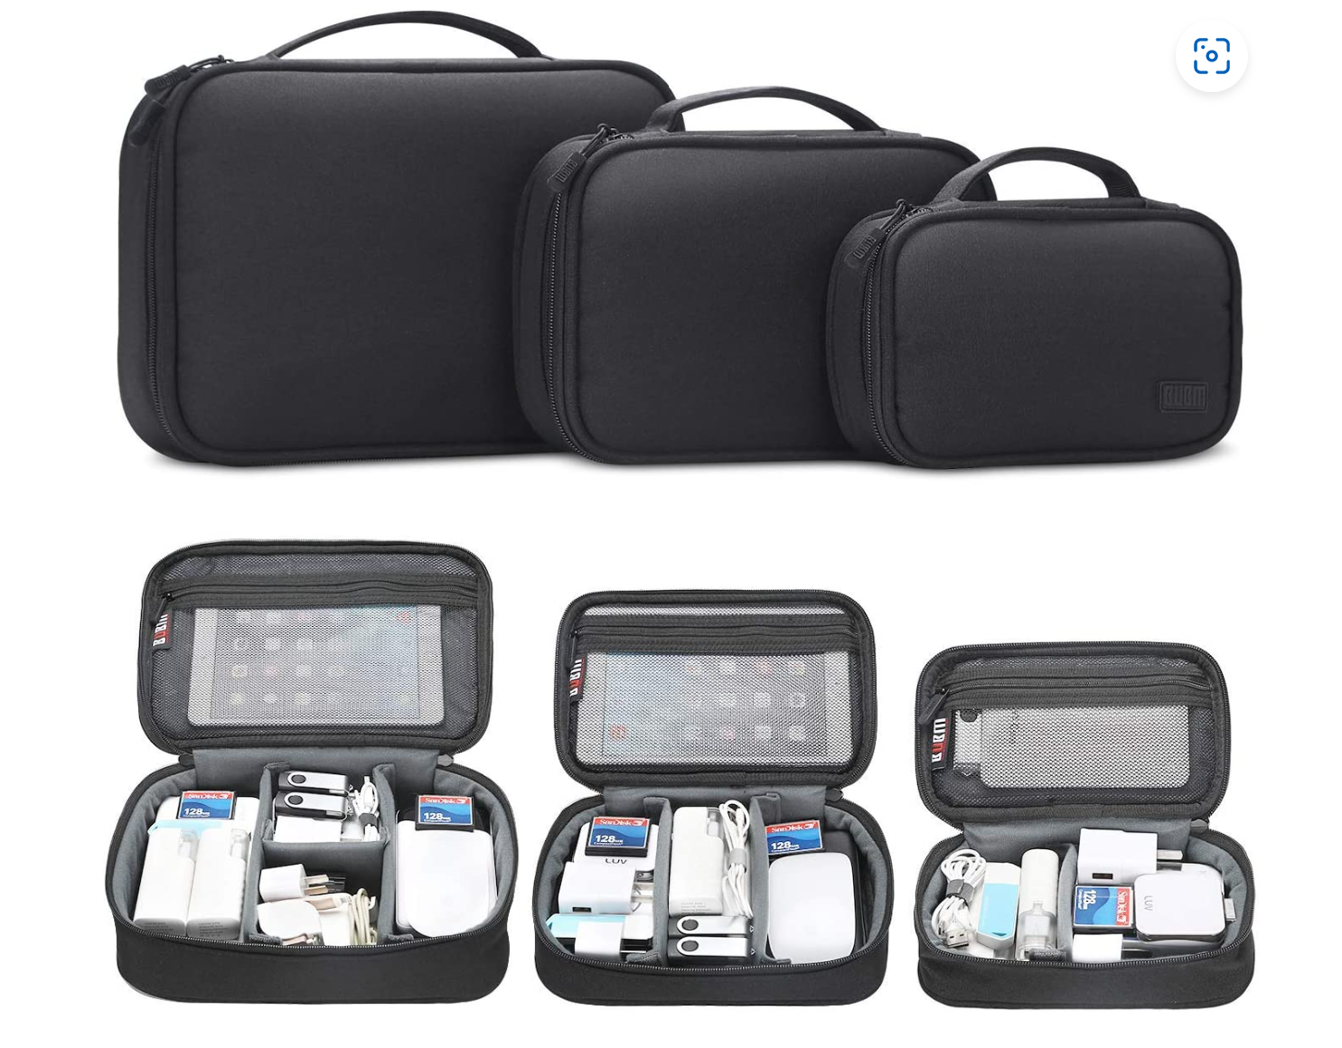
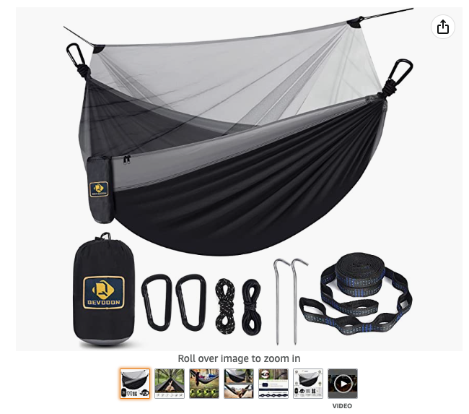
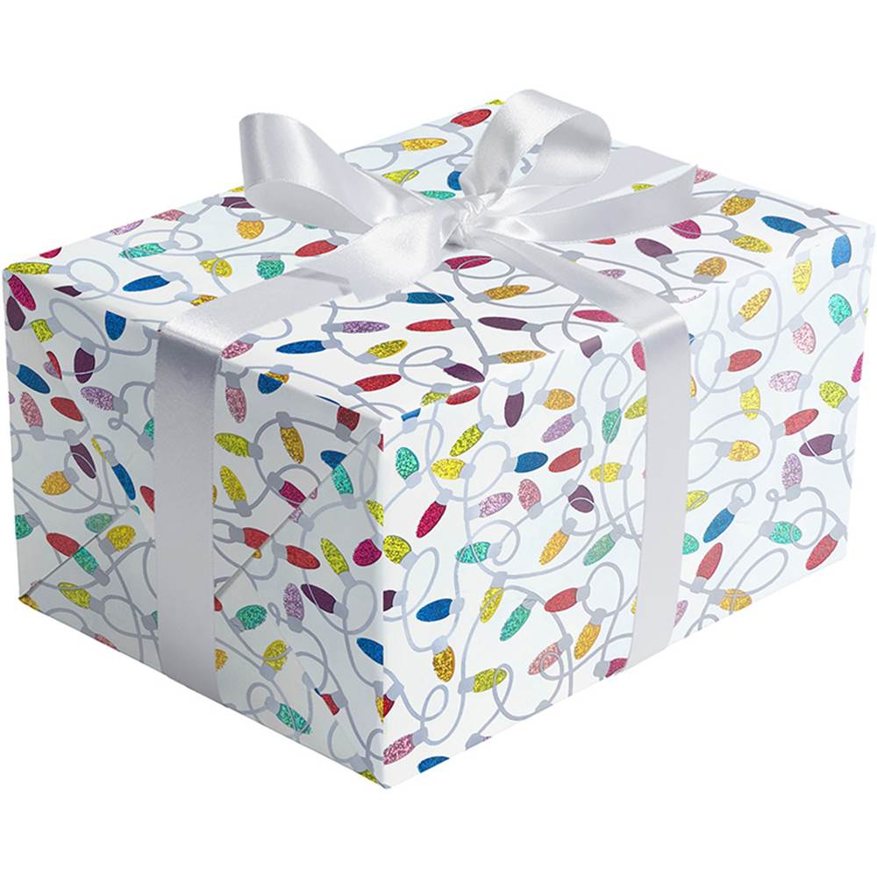

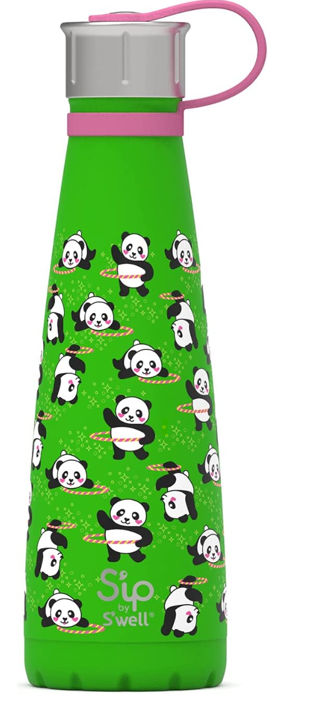
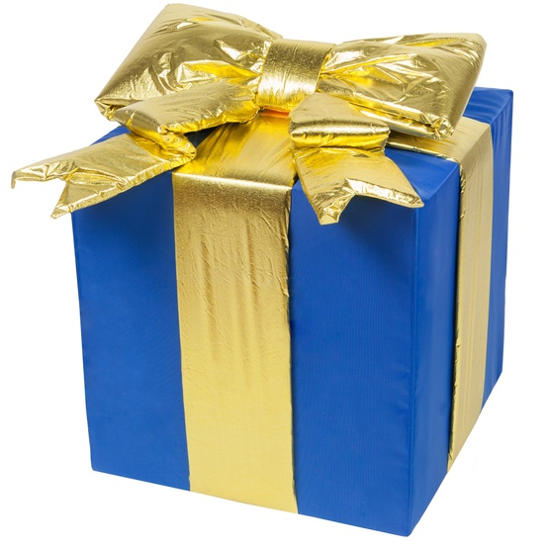
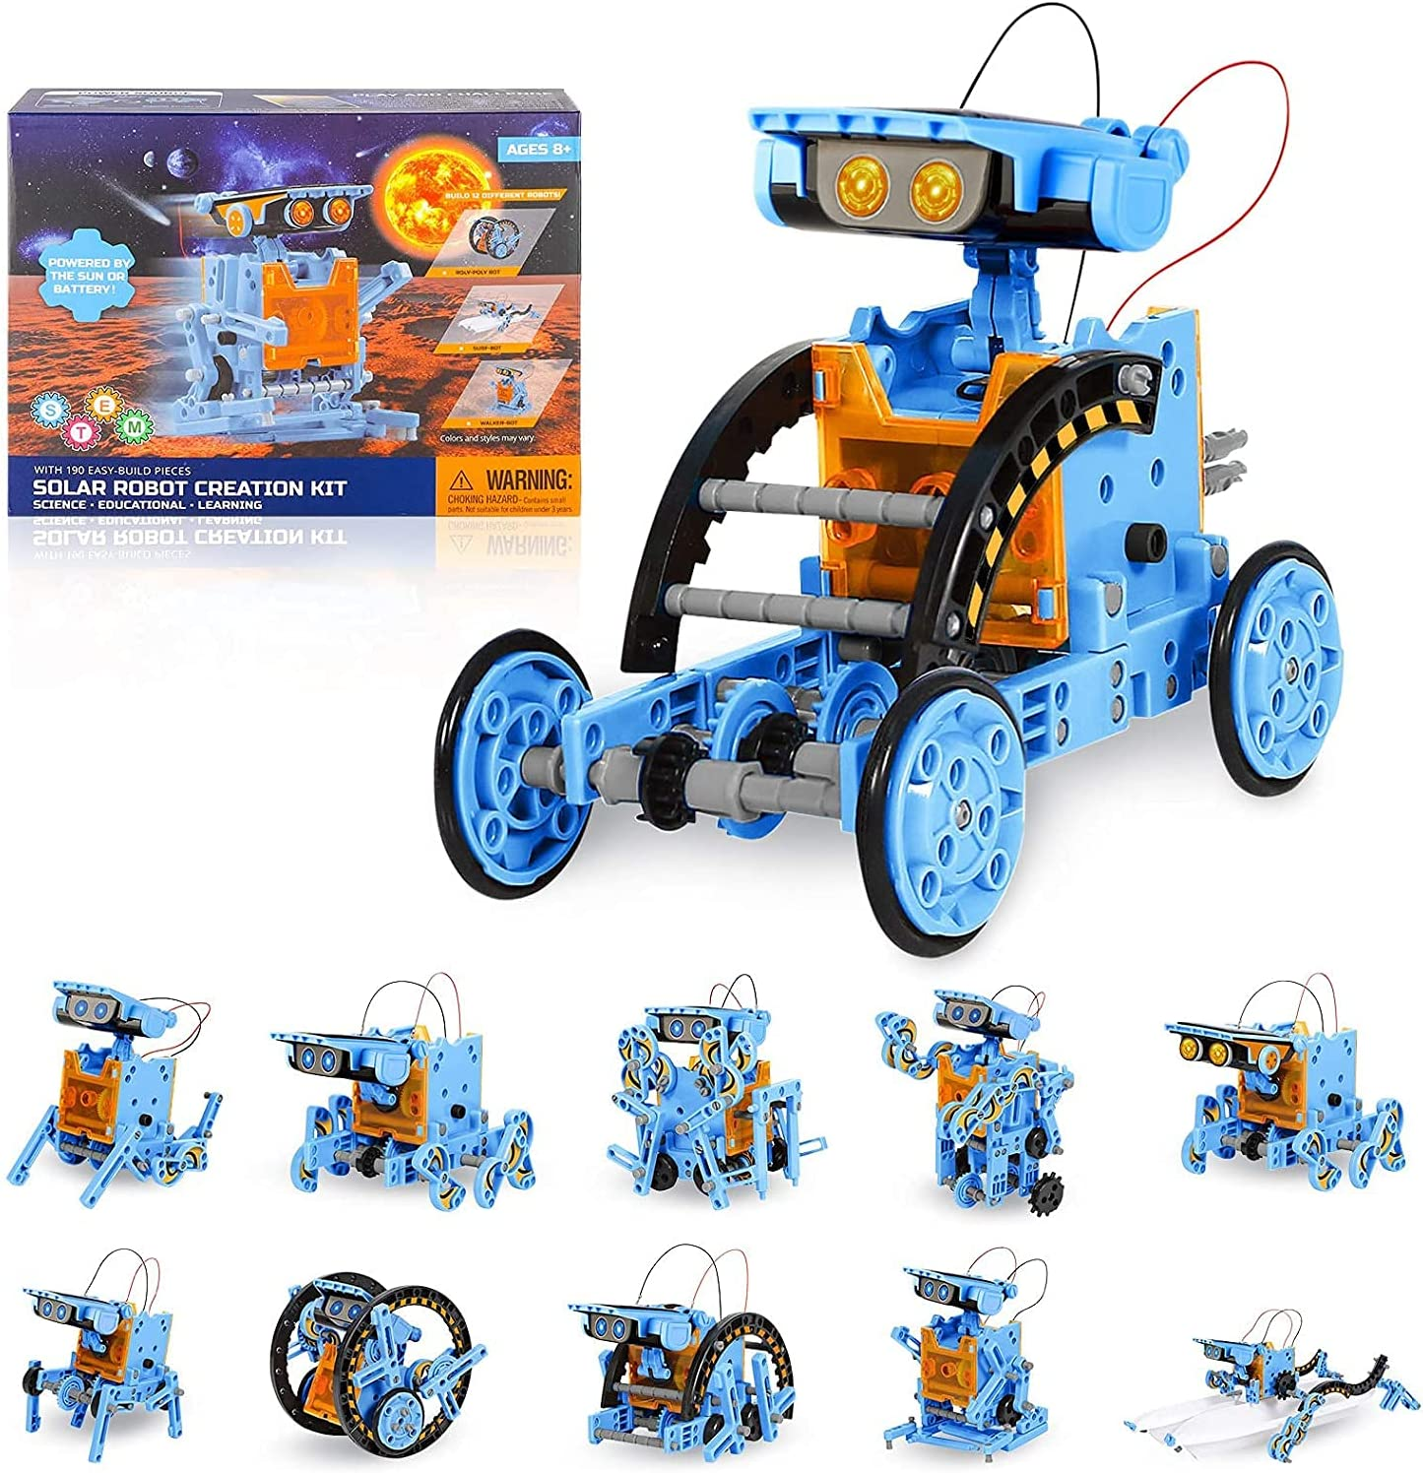
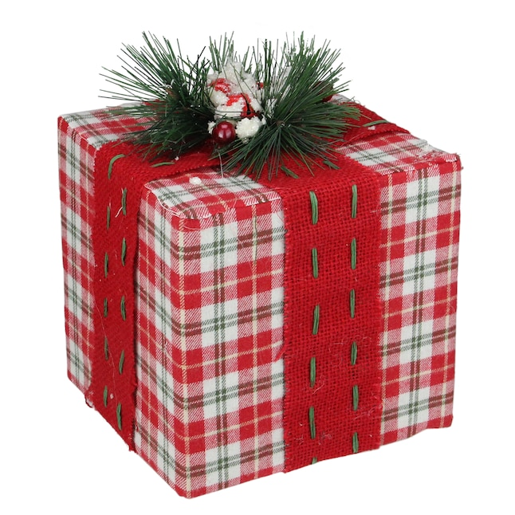
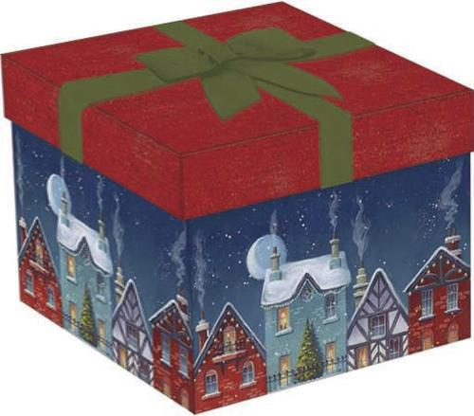
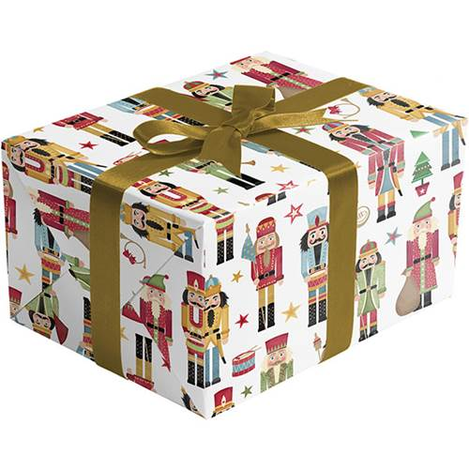
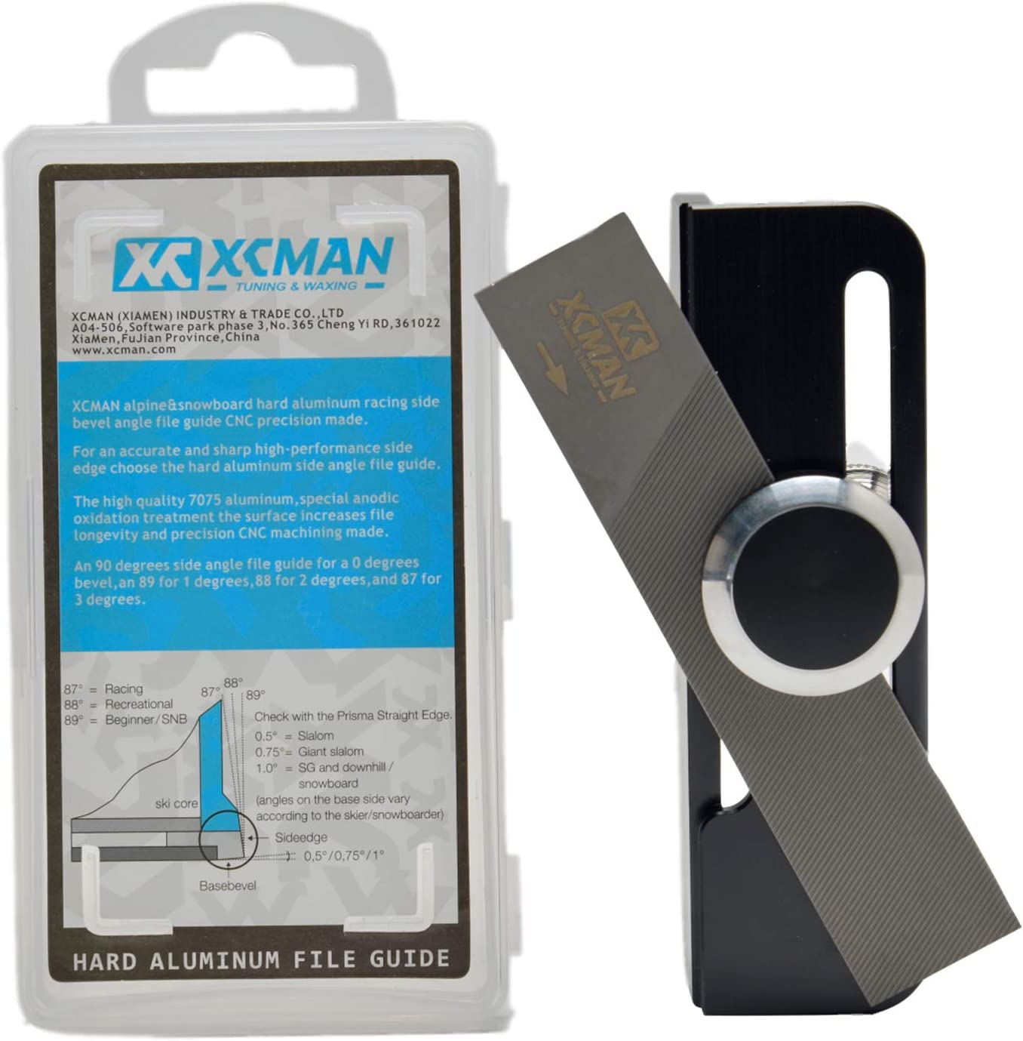
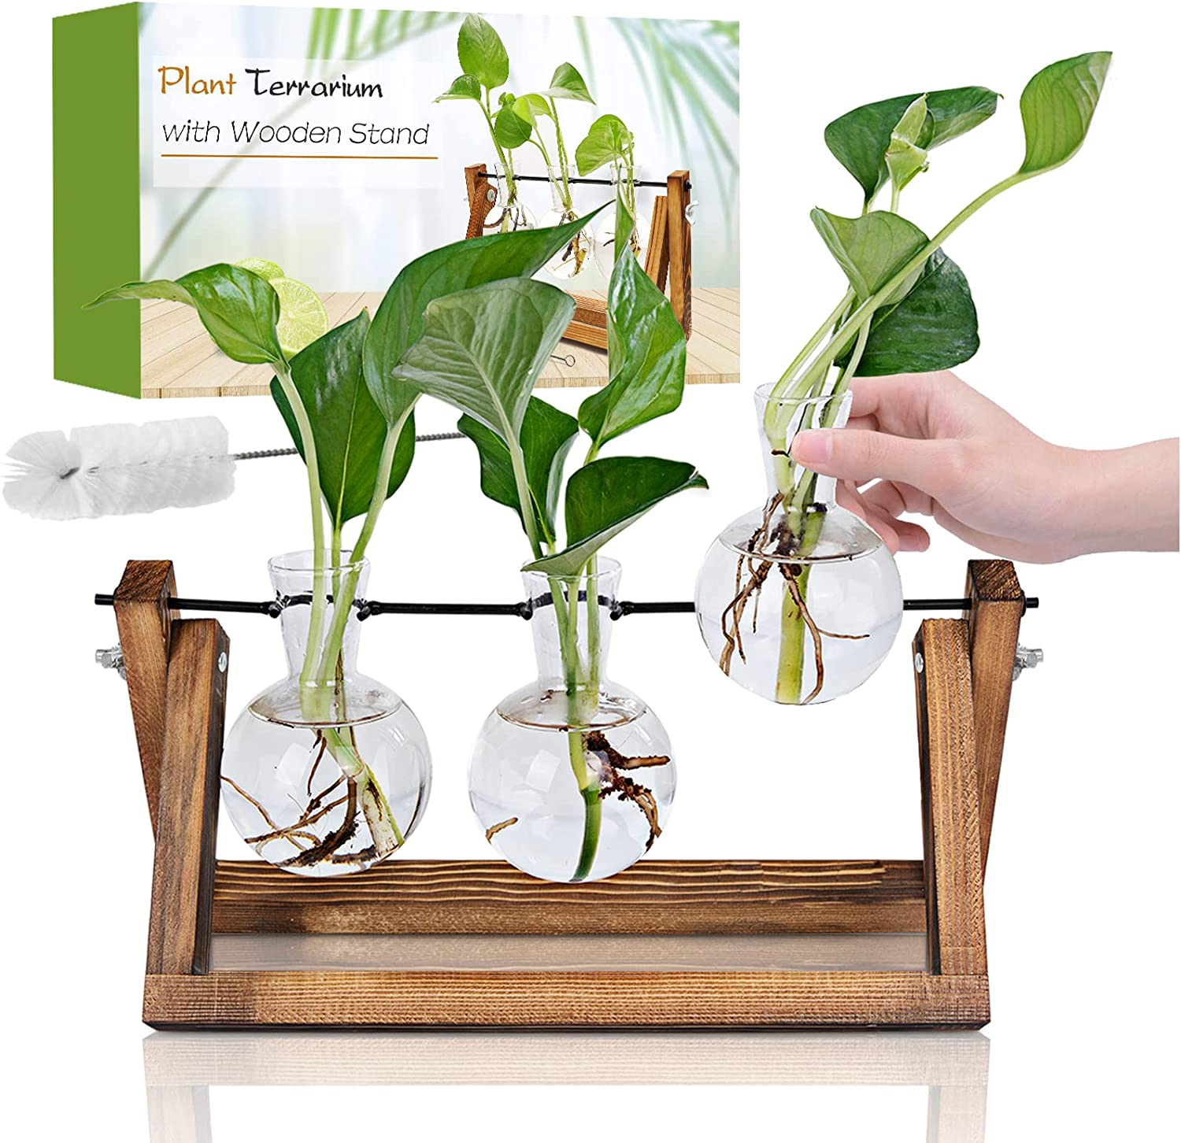

Present 1
Owned By:
1)
2)
3)
4)
Present 2
Owned By:
1)
2)
3)
4)
Present 3
Owned By:
1)
2)
3)
4)
Present 4
Owned By:
1)
2)
3)
4)
Present 5
Owned By:
1)
2)
3)
4)
Present 6
Owned By:
1)
2)
3)
4)
Present 7
Owned By:
1)
2)
3)
4)
Present 8
Owned By:
1)
2)
3)
4)
Present 17
Owned By:
1)
2)
3)
4)
Present 9
Owned By:
1)
2)
3)
4)
Present 10
Owned By:
1)
2)
3)
4)
Present 11
Owned By:
1)
2)
3)
4)
Present 12
Owned By:
1)
2)
3)
4)
Present 14
Owned By:
1)
2)
3)
4)
Present 15
Owned By:
1)
2)
3)
4)
Present 16
Owned By:
1)
2)
3)
4)
Present 18
Owned By:
1)
2)
3)
4)
Present 13
Owned By:
1)
2)
3)
4)

Slide 5


Cheese Board and Knife Set!!!

Slide 6

5-Minute Dungeon Boardgame!!

Slide 7
Tavolozza 19pcs Painting Table Easel Set, Wooden Mixed Media Art Set Easel Kit!!

Slide 8
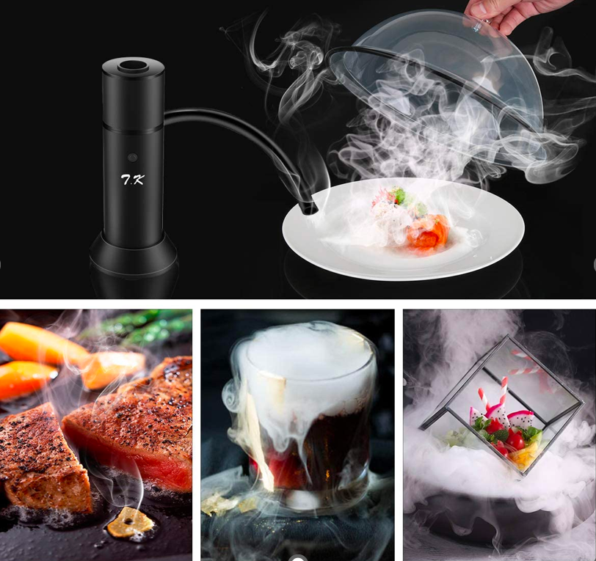
Portable Smoker!!

Slide 9

Multi-Use Hammer Tool!!

Slide 10
Teabloom Stovetop & Microwave Safe Glass Teapot !!

Slide 11
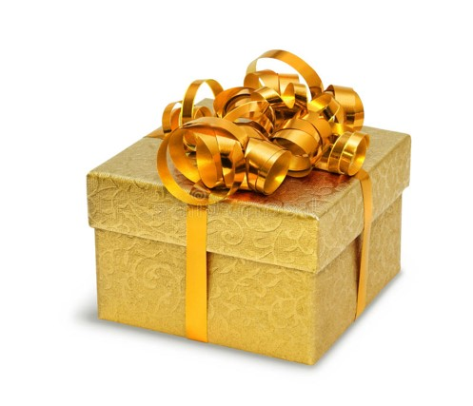
Gravity Electric Pepper and Salt Grinder Set!!

Slide 12
Multi Cube Timer/Rotating Clock!!

Slide 13

The Master Theorem - A Book of Puzzles, Intrigue and Wit !!

Slide 14

Personalized Coffee Mug with Assorted Teas!!

Slide 15
Cable Organizer Travel Bag - 3pcs !!

Slide 16
Portable Lightweight Hammock!!

Slide 17
Solar Robotics Creation Kit!!

Slide 18
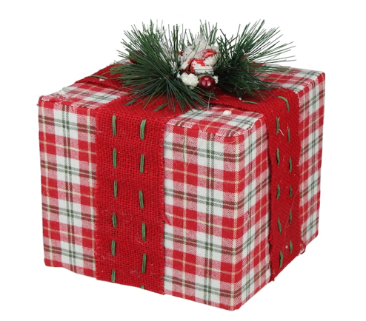
Alpine Ski Snowboard Side Edge Tuner Sharpener!!

Slide 19

Plant Propagation Terrarium!!

Slide 20
Gratitude Insight Cards!!

Slide 21
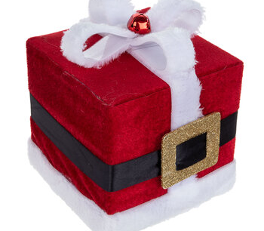
Hot Ones Truth or Dab The Game!!

Slide 22

Glow-in-the-Dark Water bottle 16 oz!!

